Slide 1

Twitter SQL Interview Question
Datalemur
By Joshua kab

Slide 2
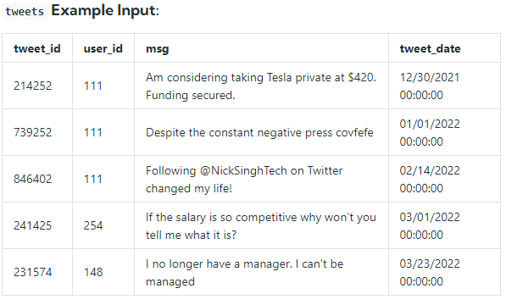
Description
Table overview
Assume you're given a table Twitter tweet data, write a query to obtain a histogram of tweets posted per user in 2022. Output the tweet count per user as the bucket and the number of Twitter users who fall into that bucket.
In other words, group the users by the number of tweets they posted in 2022 and count the number of users in each group.

Slide 3
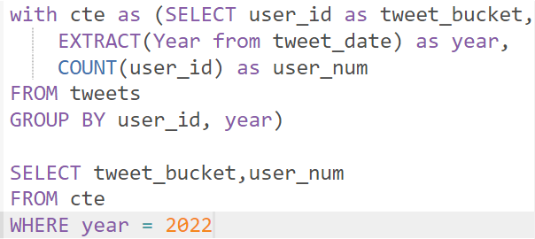
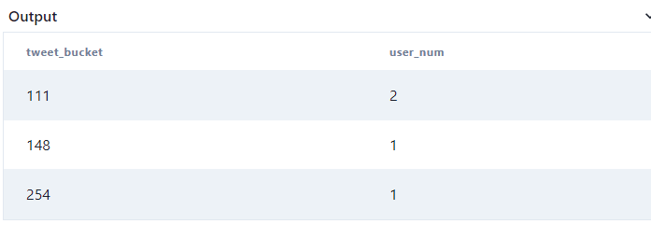
SOLUTION
result

Slide 4
THANKS…

